Slide 1


An Italian and Spanish update on Insurtech and public officer liability
Thursday 8 July 2021

Slide 2

Table of content
Trends in the insurtech landscape in Italy and Spain
Public officers liability in Italy
CMS
2

Slide 3





Laura Opilio
Partner - CMS Italy
T +39 06 478 151
E laura.opilio@cms-aacs.com
Jaime Bofill
Partner - CMS Spain
T +34 91 452 00 29
E jaime.bofill@cms-asl.com
Jorge Etreros Arnanz
Senior Associate - CMS Spain
T +34 91 452 00 32
E jorge.etreros@cms-asl.com
Nicolò d’Elia, LL.M.
Partner - CMS Italy
T +39 02 892 838 00
E nicolo.delia@cms-aacs.com
3

Slide 4
Trends in the insurtech landscape in Italy and Spain
4

Slide 5
Spain
5

Slide 6
Insurtech sector overview
The combined value of European insurtechs
(In billions of euros)
Source: Expansión – Economía digital
CMS

Slide 7
Insurtech sector overview
Source: Expansión – Economía digital
CMS

Slide 8
Insurtech sector overview
Source: Deealroom and Mundi Ventures
CMS

Slide 9
Insurtech sector overview
Europe’s insurtech startups’ ground grows at a fast pace.
Their market value has multiplied by 5 since 2016.
First it was the carriers, then came the banks, now it’s the turn of insurance companies.
Wefox, in Germany, raised $650M last June.
Industry deals are expected to accumulate €4.2B this year.
Europe is the fastest-growing region for insurtech companies, UK and Germany leading, followed by France.
Spain attracted 2% of Europe’s insurtech investments in the last 5 years, UK heading the list with 40%.
Further than London, new hubs Like Paris, Berlin, Amsterdam or Stockholm are blooming.
CMS

Slide 10
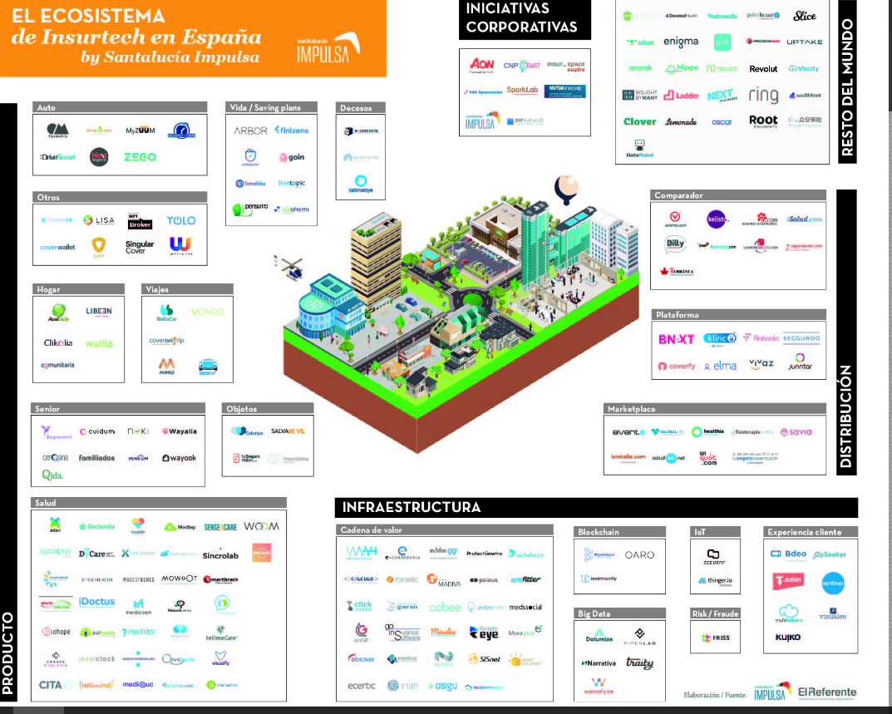
Map of insurtechs in Spain
Source: https://www.grupoaseguranza.com/noticias-de-seguros/este-mapa-las-insurtech-espana
CMS

Slide 11
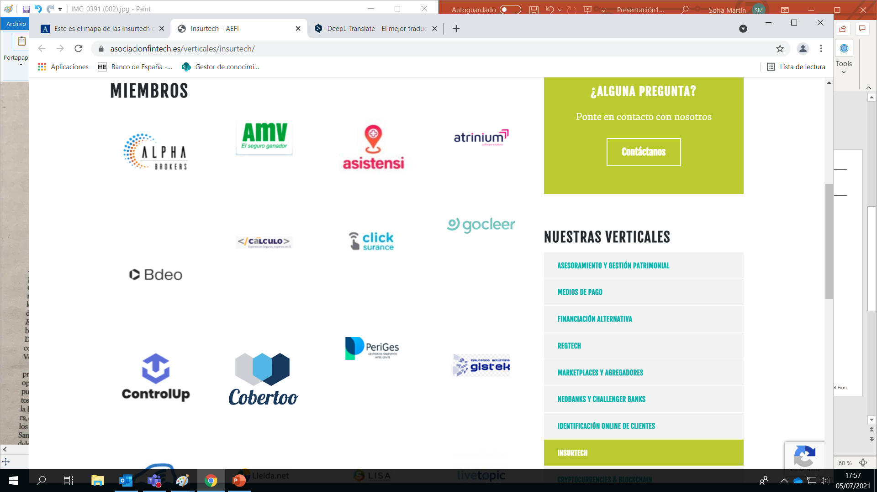
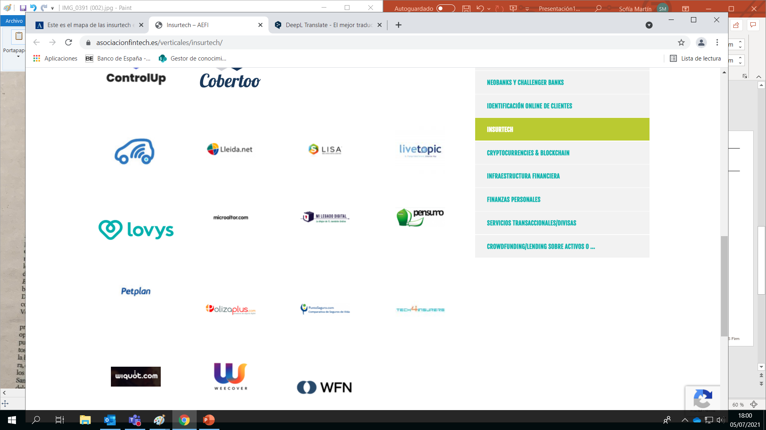
Insurtech sector members
CMS
11

Slide 12
Essential measures in the short term
Establishment of the Committee on Innovation in the Insurance Sector (CISS), comprising all players in the insurance sector.
Progress in the deployment of the regulatory sandbox.
Development of a regulatory framework tailored to the needs of P2P providers.
Reform of the corporate and commercial legislation to reflect the reality of the new entrepreneurial ecosystem.
The creation and exchange of a database containing the policies of the Spanish insurance market.
Creation of an expert group on digitalisation in the insurance and in the insurtech sector by the DGSFP.
The implementation of an updated API standard that ensures barrier-free entry for all actors taking into account the new technological needs of the market.
CMS

Slide 13
Essential measures in the short term
The publication of questions and answers (Q&A) on relevant topics and common concerns
The establishment of an insurance distribution framework that takes into account the needs of APIfication within the insurance market.
The possibility to deliver data to the insured party through a digital procedure as well as to ensure the correct integration of digital channels.
Allowing access to the Commercial Register of private documents.
Allowing the transfer of company shares by private document.
Soften the treasury stock regime and the financial assistance ban.
Expand the acceptance of electronic signatures for all necessary documents, both in the incorporation and in the day-to-day management.
Facilitate traditional insurers to carry out the necessary modifications to achieve public APIs.
CMS

Slide 14
Italy
14

Slide 15
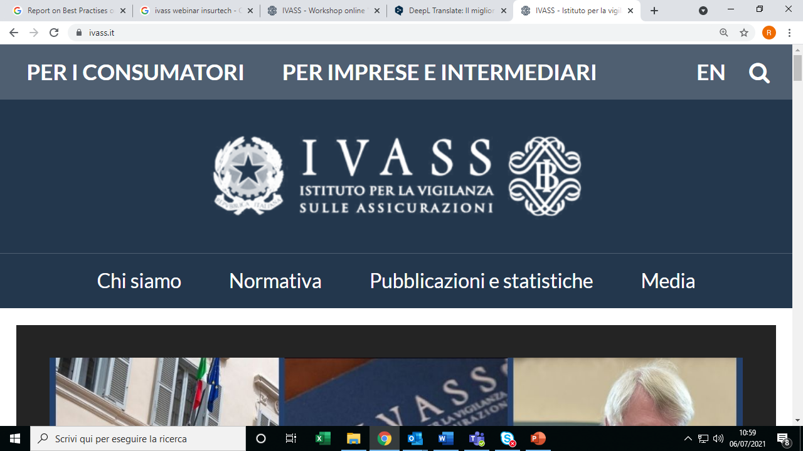

The Authorities' focus on Insurtech
Online Workshop «Innovazione digitale, ecosistema assicurativo, inclusione e mutualità» («Digital innovation, insurance ecosystem, inclusion and mutuality») - 10 March 2021.
“Report on Best Practises on Licencing Requirements, Peer-to-Peer Insurance and the Principle of Proportionality in an InsurTech Context” - 19 March 2019.
“Open insurance: accessing and sharing insurance-related data” - 28 January 2021.
“Discussion paper on blockchain and smart contracts in insurance” - 29 April 2021.
CMS

Slide 16
The Authorities' focus on Insurtech
Main findings:
Insurtech is a cross-border phenomenon that would require regulation at European level rather than at Member State level.
As far as insurance distribution is concerned, the IDD has allowed a minimum harmonisation of Member States' regulation, while leaving Member States free to introduce more stringent rules.
CMS

Slide 17
Focus: clients’ identifications
There are no specific regulatory provisions on how insurance distributors can remotely and unambiguously identify the customer through existing information technologies.
Today:
Traditional processes: obtaining copy a valid identification document.
Audio/video sessions or self-ID sessions: e.g. by sending photographs taken during the session.
Is digital identity the future?
CMS

Slide 18
Focus: online subscription
Remote subscription systems (qualified and advanced signature) governed by the eIDAS Regulation and the Italian Digital Administration Code (digital signature) should guarantee certainty at least on:
The identity of the subscriber
The date and time of the subscription
Electronic signature devices (qualified, advanced or digital) does not help in streamlining the online subscription.
Consumers seem to prefer simple and fast (e.g. one-click) subscription processes which might create issues of identification.
Could the electionic ID card be used as signature device?
CMS

Slide 19
Focus: demands and needs
Both the IDD and the Italian implementing regulations require distributors to assess the adequacy of the policy scope by understanding the customer’s specific needs.
This mechanism could be an obstacle the simple and fast online subscription systems.
The Administrative Court of Lazio, by decision of 23 June 2021, has partially annulled IVASS Order no. 97/2020 on the grounds that it had introduced additional requirements "not useful to the insured party and not appropriate in relation to the subject matter of a wide range of insurance contracts".
IVASS does not seem to have considered the specificities of online distribution, setting identical rules for traditional and remote distribution.
CMS

Slide 20
Spain
20

Slide 21
Insurtech trends in Spain: Insurers
Artificial Intelligence – Credit scoring
Wearables – Internet of the things
Chatbots
On-demand Insurance
Spanish sandbox
CMS
21

Slide 22
Insurtech trends in Spain: Insurance distributors
Comparators
Agregators
Co-design of Insurance products
Additional free services
Use of artificial intelligence by Insurance brokers
CMS
22

Slide 23
Public officers liability in Italy
23

Slide 24
The reform
By the entry into force of Law Decree 76/2020, administrative or accounting liability of Public Officers will only be limited to fraudulent behaviours.
Prior to the entry into force of the Decree, gross negligence was sufficient to raise administrative liability.
Limitation only applies to acts. In case of omissions or inertia, gross negligence liability is still admitted.
The reason for the legislative reform is to speed up administrative action, especially in the current pandemic context, by limiting the area of responsibility of employees.
The new rules, initially envisaged for a period between the date of entry into force of the Decree, i.e., 16 July 2020, and 31 December 2021, was further deferred to 31 December 2023 through the recent Decree Law n. 77 of 31 May 2021.
The new rules only apply to behaviours carried out between 16 July 2020 and 31 December 2023. Claims made in the same period bur referred to behaviours committed outside this period are still subject to the previous law.
CMS

Slide 25
The impact on insurance coverage
In Italy, public officials and employees are personally liable for damages caused to the State or the entity they belong to as a result of intentional or grossly negligent conduct.
For this reason, public officials and employees are used to taking out personal policies to cover any administrative or accounting liability.
By the above-mentioned reform, administrative or accounting liability will be extremely reduced, given that in many cases it will only be linked to willful misconduct.
Willful misconduct cannot be covered by insurance. Cover may only be granted in case of gross negligence, which may only occur due to omissions or inaction on the part of the public official or employee.
Therefore, when underwriting P.O. policies, Uws should consider the limited risk.
The possible effect on the PO insurance market in terms of premium payments cannot be disregarded.
CMS
25

Slide 26
Laura Opilio
Partner - CMS Italy
T +39 06 478 151
E laura.opilio@cms-aacs.com
Jaime Bofill
Partner - CMS Spain
T +34 91 452 00 29
E jaime.bofill@cms-asl.com
Jorge Etreros Arnanz
Senior Associate - CMS Spain
T +34 91 452 00 32
E jorge.etreros@cms-asl.com
Nicolò d’Elia, LL.M.
Partner - CMS Italy
T +39 02 892 838 00
E nicolo.delia@cms-aacs.com

Slide 27
Your free online legal information service.
A subscription service for legal articles
on a variety of topics delivered by email.
cms-lawnow.com
The information held in this publication is for general purposes and guidance only and does not purport to constitute legal or professional advice.
CMS Legal Services EEIG (CMS EEIG) is a European Economic Interest Grouping that coordinates an organisation of independent law firms. CMS EEIG provides no client services. Such services are solely provided by CMS EEIG’s member firms in their respective jurisdictions. CMS EEIG and each of its member firms are separate and legally distinct entities, and no such entity has any authority to bind any other. CMS EEIG and each member firm are liable only for their own acts or omissions and not those of each other. The brand name “CMS” and the term “firm” are used to refer to some or all of the member firms or their offices.
CMS locations:
Aberdeen, Abu Dhabi, Algiers, Amsterdam, Antwerp, Barcelona, Beijing, Beirut, Belgrade, Berlin, Bogotá, Bratislava, Bristol, Brussels, Bucharest, Budapest, Casablanca, Cologne, Dubai, Duesseldorf, Edinburgh, Frankfurt, Funchal, Geneva, Glasgow, Hamburg, Hong Kong, Istanbul, Johannesburg, Kyiv, Leipzig, Lima, Lisbon, Ljubljana, London, Luanda, Luxembourg, Lyon, Madrid, Manchester, Mexico City, Milan, Mombasa, Monaco, Moscow, Munich, Muscat, Nairobi, Paris, Podgorica, Poznan, Prague, Reading, Rio de Janeiro, Rome, Santiago de Chile, Sarajevo, Seville, Shanghai, Sheffield, Singapore, Skopje, Sofia, Strasbourg, Stuttgart, Tirana, Utrecht, Vienna, Warsaw, Zagreb and Zurich.
cms.law
CMS

