Slide 1

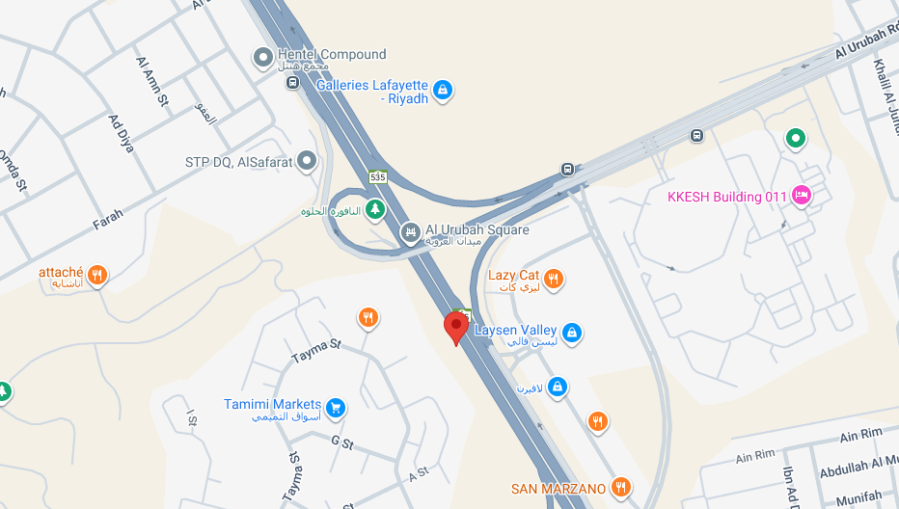
Address & Map
Riyadh, Saudi Arabia
Our Address
CMS Cameron McKenna Nabarro Olswang Lawyers and Consultants
Laysen Valley Building No. 13
Intersection King Khalid with Oruba Road
Riyadh 12329
Saudi Arabia
T +966 55412 8888

Slide 2
Directions
Riyadh office
From the Airport
King Khalid International Airport is situated 30 KM away from our office in Laysen Valley. The journey by car takes approximately 30 minutes and official airport-run taxis are available at all terminals for approximately 130 SAR. .

