Slide 1

Central & Eastern Europe Webinar | Recent developments impacting the insurance sector
10 December 2020

Slide 2
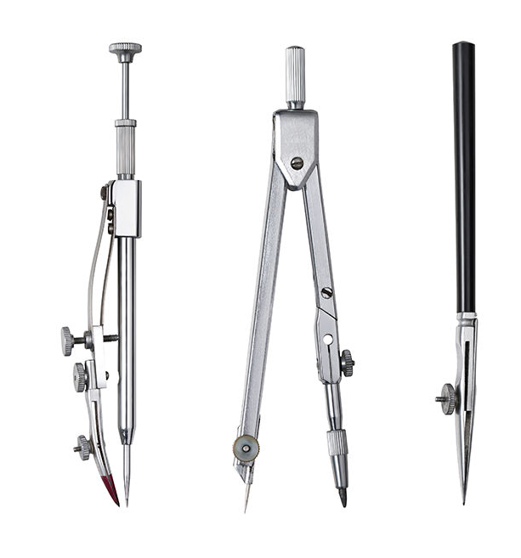
Agenda
Multi-jurisdictional
Guidelines on Information and Communication Technology Security and Governance from the European Insurance and Occupational Pensions Authority (EIOPA)
Bulgaria
Online insurance
Novelties on the MTPL insurance market
Czech Republic
Draft Bill on the Protection of Whistle-blowers Act
5th AML Directive into Czech AML law
Romania
New draft norm from the Romanian Financial Supervisory Authority to repeal and replace the current insurance distribution norm (Norm 19)

Slide 3
Speakers
Nevena Radlova
Counsel - Bulgaria
T +359 2 923 4866
E nevena.radlova@cms-cmno.com
Petr Benes
Senior Associate - Czech Republic
T +420 296 798 864
E petr.benes@cms-cmno.com
Cristina Popescu
Senior Counsel - Romania
T +40 21 407 3811
E cristina.popescu@cms-cmno.com

Slide 4
Multi-jurisdictional

Slide 5

Guidelines on Information and Communication Technology Security and Governance from EIOPA
issued by EIOPA on 12 October 2020
provides guidance to national supervisory authorities & market participants on how regulation regarding operational risks
is applied in the case of ICT security and governance
objective: promote the increase of operational resilience
of digital operations of insurance/reinsurance undertakings.
In particular, to:
  provide clarification and transparency on minimum
  required information and cyber security capabilities;
  avoid potential regulatory arbitrage;
  foster supervisory convergence.
national supervisory authorities expected to apply
Guidelines from 1 July 2021.

Slide 6
Guidelines on Information and Communication Technology Security and Governance from EIOPA
    Integrate ICT security within system
    of governance and set up ICT security strategy
Implement procedures to monitor activities that impact information security
    Identify, assess and monitor ICT security risks and audit governance, systems and processes periodically for ICT and security risks
Perform information security reviews, assessments and testing to identify vulnerabilities in ICT systems and services
    Establish a written information security policy
Establish information security training programs for all staff
Establish an information security function (independent & objective) - a designated responsible, reporting to the management body
Implement an incident & problem management process to monitor operational or security incidents
Implement procedures for logical access control/security (identity and access management)
Develop business continuity and response & recovery plan

Slide 7
Bulgaria

Slide 8

Online Insurance
Concluding of insurance contracts entirely online - is it possible?
Requirements for distance conclusion of an insurance contract:
  on a paper carrier with handwritten signatures; or
  in an electronic form, signed by a qualified electronic signature.
Additional requirements for distance marketing of financial services to consumers
What are the risks if the requirements are not observed?
What could be a feasible solution?

Slide 9

Novelties on the MTPL insurance market
The motor vehicle third party liability insurance: obligatory for all motor vehicles registered or driven in Bulgaria
The idea behind a bonus-malus system: no-claims discount for good drivers, and eventually reducing the number of road traffic accidents
Two attempts to set up a bonus-malus system
What next?
9

Slide 10

Czech Republic

Slide 11

Protection of Whistleblowers
Draft Bills on the Protection of Whistleblowers
One by the Ministry of Justice
One from the Chamber of Deputies
Implementing Directive (EU) 2019/1937 of the European Parliament and of the Council of 23 October 2019 on the protection of persons who report breaches of Union law
The aim is to ensure the protection of people who work in the private or public sector and who report illegal acts of which they have become aware in connection with the performance of their work
Expected to come into effect until 17 December 2021

Slide 12

Draft Bill from the Ministry of Justice
Introduces the institute of „significant notification“ which shall involve specific information on the breach of criminal / civil law
Introduces an obligation for certain entities to set up an internal notification system
external notification system
Prohibition of retribution against whistleblowers

Slide 13
5 AML Directive
Directive (EU) 2018/843 of the European Parliament and of the Council of 30 May 2018 amending Directive (EU) 2015/849 on the prevention of the use of the financial system for the purposes of money laundering or terrorist financing, and amending Directives 2009/138/EC and 2013/36/EU
Amendment to the existing Czech AML Act
New Act on the Ultimate Beneficial Owner (UBO) Registry

Slide 14

Draft Bill on the UBO Registry
It will now be possible for several natural persons to be the UBO acting independently from each other
If ownership interest in a corporation is managed in a trust fund, the UBO will be determined in relation to the corporation, not the trust fund
The UBO registry will be public only in part (data such as full name, registered address, nationality and reason underlying the UBO status shall be made public)
14

Slide 15

Draft Bill on the UBO Registry
Sanctions
Monetary fine up to CZK 500,000 (EUR approx. 20,000) for failure to register UBO or if the data do not correspond to reality
Contracts entered into by companies who are obliged entities and do not have the UBO registered in the registry may not be enforceable regardless of the governing law
Prohibition to pay out dividends
by corporations to UBOs who are not registered in the UBO registry

Slide 16

Romania

Slide 17

Draft insurance distribution norm
October 2020 – Romanian Financial Services Authority (“FSA”) published draft Norm on insurance distribution (to repeal/replace current FSA Norm no. 19/2018 on insurance distribution) (the “Draft”)
the Draft was subject to public consultation until end of October 2020 and it is currently undergoing internal procedures at FSA level;
final wording not yet available

Slide 18

Draft insurance distribution norm
Main changes:
eliminates written form for mandate to be given by individuals to primary intermediaries (currently a brokerage/intermediation mandate is mandatory);
eliminates minimum clauses and termination conditions for brokerage/intermediation mandates (now subject to freedom of form/contract);
eliminates restriction on distribution of competing insurance products for non-banking financial institutions and other entities regulated/supervised by the NBR/FSA (restriction subsists for other ancillary intermediaries)

Slide 19

Draft insurance distribution norm
Main changes (cont’d):
eliminates requirement for prior information of and approval by client in the context of a collaboration between primary intermediaries;
eliminates current prohibition for individuals holding executive management positions in insurance intermediaries to also hold management positions in any other Romanian or foreign legal entity (the prohibition is now limited to entities in the insurance/reinsurance sector);
supplements the list of permitted activities for brokerage companies with intermediation of road assistance services, medical services and other post-sale services for their own clients.

Slide 20
Nevena Radlova
Counsel - Bulgaria
T +359 2 923 4866
E nevena.radlova@cms-cmno.com
Petr Benes
Senior Associate - Czech Republic
T +420 296 798 864
E petr.benes@cms-cmno.com
Cristina Popescu
Senior Counsel - Romania
T +40 21 407 3811
E cristina.popescu@cms-cmno.com

Slide 21

Your free online legal information service.
A subscription service for legal articles
on a variety of topics delivered by email.
^{cms-lawnow.com}

