Slide 1
FSR: one year of enforcement
EU Competition Law Briefings

Slide 2


Agenda
The FSR Framework
The implementation of FSR by the European Commission
Tips and tricks

Slide 3
The FSR Framework

Slide 4
Objectives
Addressing distortions caused by foreign subsidies in the context of :
Guaranteeing a level playing field for all undertakings operating within the EU:
  Acquisition or merger of undertakings active in the EU
  Participation in public procurement and concession procedures
  Other market situations
Target the subsidies with the most distortive effect
Minimize administrative constraints via :
  High notification thresholds
  Alignment on merger control concepts and procedures
Legal gap to be filled
BUT respect of international obligations, in particular those of the WTO
  Non-discrimination principle
  Avoid conflicts with existing rules (agreement on subsidies and countervailing measures)

Slide 5
Milestones of the FSR
12 January 2023
Entry into force of Regulation on foreign subsidies distorting the internal market (EU) 2022/2560
The European Commission may investigate financial contributions granted by third countries to all European and foreign undertakings and, if necessary, remedy their distortive effects
Undertakings must notify/declare these financial contributions in the event of concentration or participation in public procurement and concession procedures above certain thresholds
June 2023
Questions and Answers of the European Commission relating to mergers
Questions and Answers of the European Commission relating to public procurement and concessions
10 July 2023
Regulation on detailed arrangements for the conduct of proceedings (EU) 2023/1441
12 July 2023
Start of the Commission’s investigative powers
12 October 2023
Obligation to notify concentrations and public procurement / concessions

Slide 6
“Financial contribution” and “foreign subsidy” under the FSR
Financial contribution:
Broad notion including direct grants, fiscal incentives, the remuneration of goods or services, public debt write-offs, public loans and guarantees, capital injections granted :
Directly by a third country (non-EU) : Switzerland, UK, Norway, Iceland, etc.
Via public or private entities
Foreign subsidy:
Financial contribution directly or indirectly provided by a third country AND
Which confers a benefit to an undertaking engaging in an economic activity in the internal market, AND
Which is limited, in law or in fact, to one or more undertakings or industries
The financing of non-economic activities is excluded

Slide 7
Commission analysis
FOREIGN FINANCIAL CONTRIBUTIONS
subsidies
Interest-free loans
Unlimited guarantees
Capital injections
Tax advantages
Debt write-offs
Remuneration for the purchase of goods or services
PROCEDURE
1. Ex–ante notification above certain thresholds :
Concentration
Public procurement/concession
2. Ad hoc notification below thresholds
3. Ex officio investigation, applicable to any market situation
ASSESSMENT OF DISTORTION
Damage to competition in the internal market ?
Indicators of a distortion : amount, form and purpose of the subsidy, situation of the undertaking, markets concerned, etc.
BALANCING TEST
Balancing the negative effects in terms of the distortion with the positive effects of the subsidy on the development of the subsidized economic activity
REMEDY THE DISTORTION
Structural or non-structural redressive measures
Prohibition of concentration or award of public procurement/concession

Slide 8
Analysis criteria
Adoption of guidelines 3 years after the entry into force of the FSR
Criteria for assessing distortion
Balancing test
Assessment of distortion in public procurement/concession procedures
Power to request ad hoc notification for concentrations or public procurement/concession procedures below the thresholds
26 July 2024: Initial clarifications on the assessment of the distortion of competition

Slide 9
Thresholds for notification and control of foreign subsidies
Notification for concentration
Notification for public procurement/concession procedures
The EU turnover of the company to be acquired/at least one of the merging parties/the JV exceeds EUR 500 million
AND
FFCs above EUR 50 million during last three years
Estimated public contract value is at least EUR 250 million (value of lot or combined lots equal to or exceeding EUR 125 million)
AND
FFCs above EUR 4 million per non-EU country during last three years
Ex officio investigations for other markets situation
Declaration in public procurement/concession procedures
Every foreign subsidies above the de minimis aid cap
Below the notification thresholds
Exception of the de minimis application

Slide 10




Foreign subsidies in concentrations - What to include in the notification?
DETAILED INFORMATION
FFCs most likely to distort the internal market (Article 5 : undertaking in difficulty, unlimited guarantee, export financing measure not in line with OECD, FFCs facilitating a concentration)
Which exceed EUR 1 million
Granted individually during the last 3 years
SPECIFIC INFORMATION
FFCs that may fall under Article 5
Which exceed EUR 1 million
Granted individually during the last 3 years
PRESENTATION OF THE PROCEDURE
Presentation of the concentration
Information about the parties
Description of the concentration, ownership and control
Impact on the internal market of the FFCs in the concentration
Positive effect; Supporting documentation
GENERAL OVERVIEW
For all other FFCs (that do not fall under Article 5):
Only individual amount above EUR 1 million
Only if at least EUR 4 million per country over the last 3 years
→ TABLE
EXCLUDED FROM REPORTING
Remuneration of sale of goods and services at market prices
Tax deferrals or double taxation relief
FFCs below EUR 1 million
Private equity: only FFCs to the Specific Fund

Slide 11
Foreign subsidies in public procurement/concession procedures - What to include in the notification?
DETAILED INFORMATION
FFCs most likely to distort the internal market (Article 5 : undertaking in difficulty, unlimited guarantee, export financing measure not in line with OECD, unduly advantageous tender)
Which exceed EUR 1 million
Granted individually during the last 3 years
SPECIFIC INFORMATION
FFCs that may fall under Article 5
Which exceed EUR 1 million
Granted individually during the last 3 years
PRESENTATION OF THE PROCEDURE
Description of the public procurement / concession
Information about the notifying party
Justification for absence of unduly advantageous tender
Positive effect; Supporting documentation
GENERAL OVERVIEW
For all other FFCs (that do not fall under Article 5):
Only individual amount above EUR 1 million
Only if at least EUR 4 million per country over the last 3 years
→ TABLE
EXCLUDED FROM REPORTING
Goods and services at market prices
Tax deferrals or double taxation relief
FFCs below EUR 1 million

Slide 12
Procedure
Concentrations
(DG COMP)
Public procurement/concession procedures
(DG GROW)
Prenotification
Notification:
Preliminary review: 25 working days
In-depth investigation: 90 working days
Prenotification
Notification:
Preliminary review: 20 working days
In-depth investigation: 110 working days
Declaration
Stand-still obligation !

Slide 13
Safe harbour
De minimis threshold:
Foreign subsidies to a single undertaking not exceeding the de minimis aid cap are considered as not distorting the internal market
Subsidies not exceeding EUR 4 million over a consecutive three-year period should be considered not to distort the internal market (rebuttable presumption)
Possibility of exemption:
Subsidies granted to make good the damage caused by natural disasters or exceptional occurrences are not considered to distort the internal market

Slide 14
Outcome of the procedure
No objection from the Commission
Authorization with remedies imposed or commitments offered by economic operator → structural or non-structural redressive measures (divestment of assets, access to infrastructure, prohibition of certain market behaviors, reimbursement of the subsidy, etc..)
Prohibition of the operation (concentration or public procurement/concession)

Slide 15
Powers of the Commission
Investigative powers
Sanction
Requests for information
Inspections within EU
Fact-findings missions outside EU
Order interim measures
Market investigation into specific sectors
Request for ad hoc notifications up to ten years after the new market situation
Fines of up to 1% of total turnover for inaccurate or misleading information
Fines of up to 10% of total turnover for failure to notify or circumvention of the notification obligation
Penalties up to 5% of the total daily turnover

Slide 16
Implementation by the European Commission

Slide 17
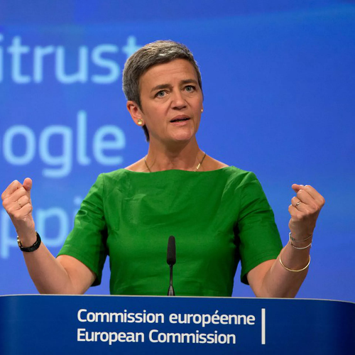
First objectives and impressions
Strong enforcement, heavy caseload – limited capacities
  “[W]e're making full use of the tools that we have. […] We need a systematic approach. And we need it before it is too late.”
The Commission has stepped up and used its strongest powers from the beginning
Main focus on China but not limited to it – „no cutting corners for US investments” either
Executive Vice President Margrethe Vestager
  “China has built up a strong position, not always playing fair. […] [G]ranting massive subsidies for domestic suppliers, while simultaneously and progressively closing the domestic market to foreign businesses.”
Expectations v. realities – higher caseload, understaffing
First 100 days:
14 M&A notifications, 53 pre-notification discussions
100+ public procurement submissions
Original plans:
140 people
Commission expectations:
~30 cases for the first year
First year (October 2024):
85 M&A notifications, 130 pre-notification discussions
Current headcount:
~40

Slide 18



Public procurement cases
First in-depth investigation under the FSR
In-depth investigation into
electric trains in Bulgaria –
February 2024
In-depth investigations into the solar photovoltaic sector in Romania –
April 2024
  Concerns public procurement procedure for electric “push-pull” trains and related maintenance and staff training services
  Target: subsidiary of Chinese state-owned train manufacturer, CRRC
  CRRC ultimately withdrew its bid
  2 investigations into a public procurement procedure for the design, construction and operation of a photovoltaic park
  Targets:
      LONGi – major supplier of solar photovoltaic solutions listed on the Hong Kong Stock Exchange
      Shanghai Electric Group – Chinese state-owned, leading global suppliers of industrial-grade solutions of energy, manufacturing and the integration of digital intelligence
Notes:
Trains, Bulgaria: https://ec.europa.eu/commission/presscorner/detail/en/ip_24_887
Solar panels, Romania: https://ec.europa.eu/commission/presscorner/detail/en/ip_24_1803

Slide 19



Merger cases I.
First completed in-depth investigation under the FSR
Conditional approval in the telecommunications sector – September 2024
  Parties:
    Acquirer: e& – a UAE-based telco operator controlled by the UAE’s sovereign wealth fund
    Target: PPF – telco operator in Czechia, Bulgaria, Hungary, Serbia (Yettel) and Slovakia (O2)
  Commission’ findings:
    e& received foreign subsidies from the UAE: unlimited state guarantee, grants, loans, etc.
    The subsidies did not lead to negative effects in the acquisition process: e& was the sole bidder, had sufficient resources → the subsidies did not alter the outcome
    However, the subsidies could have led to distortion of competition post transaction: artificially improved e&’s capacity to finance its activities in the EU market → distorting the level playing field
  Commitments – for 10 years (subject to extension for additional 5 years):
    No deviation from ordinary UAE bankruptcy law → removal of unlimited state guarantee
    Prohibition of financing from e& to PPF’s activities in the EU
    Obligation to inform the Commission on future acquisitions (non-notifiable under the FSR)
Notes:
e& conditional approval: https://ec.europa.eu/commission/presscorner/detail/en/ip_24_4842

Slide 20
Merger cases II.
First known Chinese company to receive FSR approval for a merger
Unconditional approval re refrigeration business – October 2024
  Chinese home-appliances supplier Haier received clearance to buy the commercial refrigeration business of Carrier (US-based company)
  The Commission closed its preliminary review (no in-depth investigation): “insufficient indications” for distorting foreign subsidies
  Interesting prelude: in July 2024, Haier’s acquisition attempt of Finnish company Purmo failed due to seller’s uncertainties about Haier’s ability to obtain FSR approval
Numerous cases in the pipeline from various industries (notifications pending approval/in-depth probe), e.g.:
  ABN AMRO (Dutch bank) to buy Hauck Aufhäuser Lampe (German private bank)
  Hankook (Korean tire company) to buy Hanon Systems (Korean car-parts maker)
  Japan Pulp & Paper (Japanese paper distribution company) to take over assets from Inapa (Portuguese paper distributor)
  CD&R (US private equity firm), Permira (UK investment company) to buy Exclusive Networks (French cybersecurity company)
Notes:
Haier: https://content.mlex.com/#/content/1600061/china-s-haier-gets-eu-foreign-subsidy-approval-to-buy-carrier-s-refrigeration-business-update?referrer=search_linkclick
ABN AMRO: https://content.mlex.com/#/content/1607116/abn-amro-files-acquisition-of-hal-for-eu-foreign-subsidy-review?referrer=search_linkclick
Hankook: https://content.mlex.com/#/content/1605215/korea-s-hankook-files-takeover-of-hanon-for-eu-foreign-subsidy-review?referrer=search_linkclick
Japan Pulp & Paper: https://content.mlex.com/#/content/1605079/japan-pulp-paper-seeks-eu-foreign-subsidy-clearance-for-inapa-deal?referrer=search_linkclick
CD&R/Permira: https://content.mlex.com/#/content/1602286/cd-r-permira-s-exclusive-networks-deal-is-first-merger-notification-disclosed-by-eu-under-foreign-subsidy-rules?referrer=search_linkclick

Slide 21
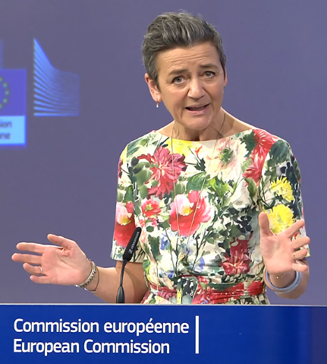
Ex officio cases
  “Our economies cannot absorb [Chinese subsidies]. It is not only dangerous for our competitiveness. It also jeopardises our economic security.”
In-depth investigation into wind turbines – April 2024
In-depth investigation into security equipment sector – April 2024
  Target: Chinese suppliers
  Investigated markets: France, Spain, Greece, Bulgaria, Romania
  Concerns: advantage over European competitors due to subsidies, e.g.:
    Much lower prices (up to 50% lower)
    Generous financing terms – up to 3 years deferred payment
  Target: Nuchtech – Chinese state-owned company specialised in security scanning equipment and systems
  The Commission also carried out dawn raids in multiple Member States
  Challenge against the dawn raid pending against the CJEU
Executive Vice President
Margrethe Vestager
“ We can't afford to see what happened on solar panels, happening again on electric vehicles, wind or essential chips.”
Notes:
Vestager speech, wind turbines: https://ec.europa.eu/commission/presscorner/detail/en/speech_24_1927
Nuchtech: https://competitionlawblog.kluwercompetitionlaw.com/2024/05/02/when-the-european-commission-rings-at-dawn-first-dawn-raid-under-the-fsr/

Slide 22



What about third-party complaints?
Extended debate on whether to create formal framework for third-party complaints
Decision: no – so that enforcement priorities can be set by the Commission (choose which cases to pick)
However, the Commission also awaits market signals – but no formal reaction/feedback is guaranteed
Foreign subsidies to be caught offside?
Potential hot topic: football clubs
  Complaints against state funding of Manchester City (UAE-owned) and Newcastle United (Saudi-owned)
  Belgian club RE Virton complained to the Commission about competing club SK Lommel, part of the City Group
  Spanish football association LaLiga urged the Commission to take action against Qatari-owned PSG
No official response from the Commission yet
Complaints from other industries: EDF (French energy giant) against Korea Hydro & Nuclear Power over Czech nuclear project
Notes:
EDF complaint: https://content.mlex.com/#/content/1601171/edf-makes-eu-foreign-subsidy-complaint-over-czech-nuclear-award-to-south-korean-operator?referrer=search_linkclick

Slide 23
Experience of the first year of enforcement
Experience so far
  Sectoral focus: primarily energy – wind, solar ↔ but multiple other sectors are also affected
  Geographical focus: the CEE region seems over-represented
  Focus re investors: primarily Chinese companies

Slide 24
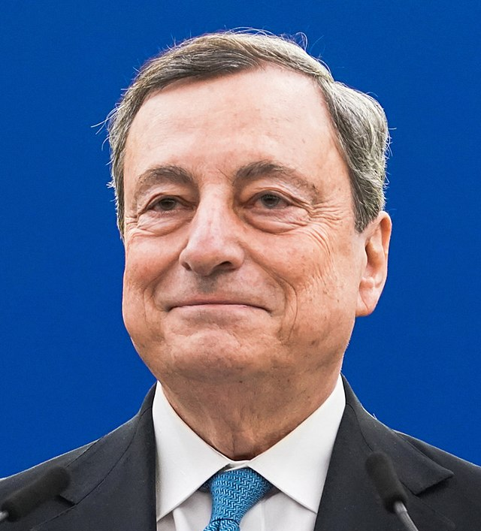
Looking to the future – What to expect in the next year(s)?
FSR enforcement likely to be a top priority
Understaffing is likely only temporary – substantial boost in resources is expected
Expected primary targets:
  „Greatest scale” issues
  Investment-heavy markets
  Greenfield investments, developing markets
  Killer acquisitions
“It is of paramount importance for the EU that these new rules [FSR] are applied effectively and result in the intended benefits for EU consumers and businesses.”
“Adequate resources must therefore be provided to the enforcer. The types of specialised knowledge required by these new powers are different.”
Also confirmed by the Draghi report:
FSR embedded into the EU policy framework – going beyond a simple competition tool
Formal antitrust instrument
EU competitiveness
EU green transition, sustainability
Notes:
Possible action against killer acquisitions: https://content.mlex.com/#/content/1559149/greenfield-investments-subsidized-goods-production-could-face-fsr-action-eu-official-says?referrer=search_linkclick

Slide 25
3. Tips and tricks

Slide 26
Tips and tricks I.
Proactive steps for potentially affected companies
Best practices for companies potentially falling under FSR thresholds due to their size and State-related income (even if not distortive):
  Advance preparation to enable swift FSR filings
  Compiling data to be included in the notification even before the start of the M&A process
  Data collection can be labour-intensive and time-consuming – challenging to fit into tight schedules of M&A processes

Slide 27
Tips and tricks II.
Best practices for potential FSR targets / their competitors
For potential targets of (ex officio) FSR investigations – “shield”:
For competitors of potential FSR targets – “sword”:
  In-depth internal audit to identify potential FSR risks
  Comprehensive risk assessment, compliance plan, defence strategy
  Assessment whether competitors benefitting from non-EU subsidies can be challenged
  Filing complaint with the Commission
Need for individual assessment / tailor-made solutions – worthwhile to consult with FSR experts

Slide 28
Questions?

Slide 29

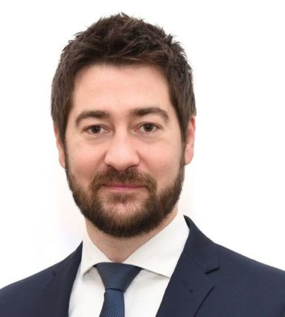
Annabelle Lepièce
Partner
T +32 2 743 69 34
F + 32 2 743 69 01
E Annabelle.lepiece@cms-db.com
CMS Belgium
Chaussée de la Hulpe 178
1170 – Bruxelles
Szabolcs Szendrő
Partner
T +36 1 483 48 96
F +36 1 483 48 01
E szablocs.szendro@cms-cmno.com
CMS Hungary
YBL Palace
Károlyi utca 12 - 1053 Budapest

